Slide 1
AI/ML SOLUTIONS
FOR FINANCIAL
SERVICES
Instructor:
PAUL J DAVIS

Slide 2
Class Schedule
01 |  |  |  |  | 02 |  |  |  | 03 |  |  |  | 04 |  |  |  | 05
AL/ML Solutions for Financial Services |  |  |  |  | ML & AI Algorithms |  |  |  | Data Management and Preprocessing + Lab |  |  |  | Credit Risk Assessment |  |  |  | Fraud Detection & Prevention + Guest Speaker
06 |  |  |  |  | 07 |  |  |  | 08 |  |  |  | 09 |  |  |  | 10
Trend Forecasting & Prediction + Lab |  |  |  |  | Trading & Portfolio Management + Guest Speaker |  |  |  | Robotic Process Automation (RPA) + Guest Speaker |  |  |  | Customer Segmentation & Personalization + Lab |  |  |  | Natural Language Processing: Virtual Assistants & Chatbots + Lab
11 |  |  |  |  | 12 |  |  |  | 13
Implementing AI & ML Solutions |  |  |  |  | Ethical and Regulatory Considerations + Guest Speaker |  |  |  | Career Guidance & Outlook
|elvtr|

Slide 3
CLASS AGENDA
01
Overview of Data Science in Financial Services
Data Structure Overview
Target Variable and Predictors Overview
Performance Metrics Overview
02
03
04

Slide 4




Data Science Roadmap
.
Fundamentals of Data Science
Overview of what data science is and its importance in decision-making
Key concepts such as data collection, data cleaning, and data types (structure vs. unstructured data).
Main Types of Data Analysis
Descriptive Analysis: Understanding what happened based on historical data
Predictive Analysis: Predicting future outcomes using statistical and ML models.
Applications in Real-World Scenarios
Real-world examples of how data science is applied in financial services.
Discussion on ethical considerations and the impact of data science on society

Slide 5
Data Science Roadmap
Fundamentals of Data Science
Overview of what data science is and its importance in decision-making
Key concepts such as data collection, data cleaning, and data types (structure vs. unstructured data).
Main Types of Data Analysis
Descriptive Analysis: Understanding what happened based on historical data
Predictive Analysis: Predicting future outcomes using statistical and ML models.
Applications in Real-World Scenarios
Real-world examples of how data science is applied in financial services.
Discussion on ethical considerations and the impact of data science on society

Slide 6
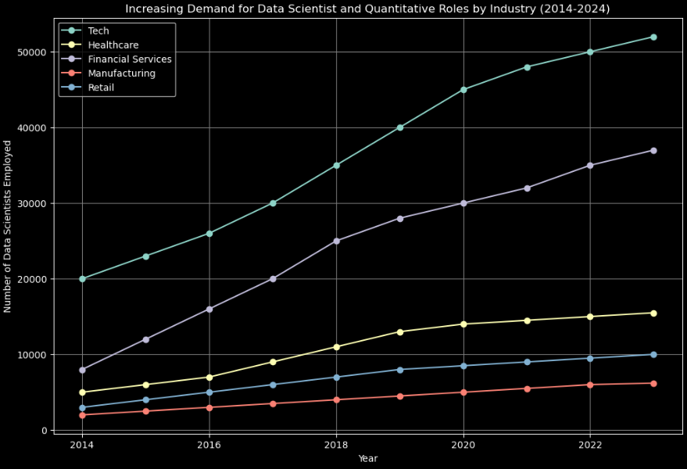
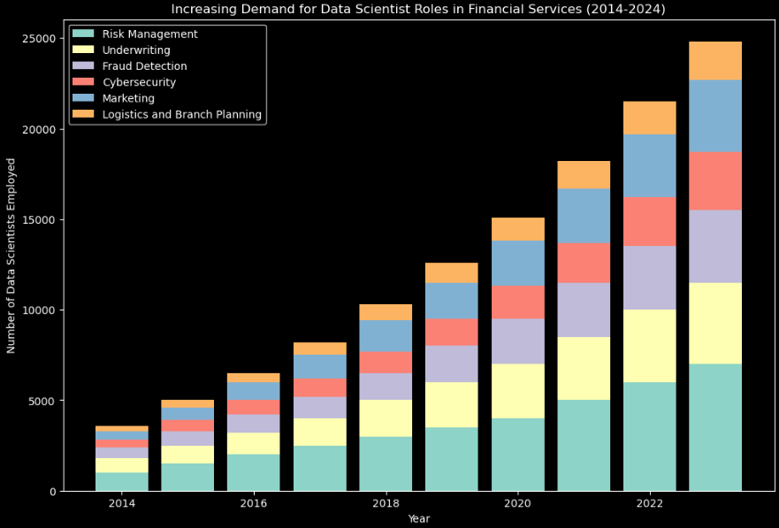
The Data Science Employment Landscape
Unlocking New Opportunities: As AI and ML technologies continue to evolve, they are unlocking unprecedented opportunities across all sectors. Data scientists are at the forefront, driving innovation and efficiency in ways never imagined before.
A Growing Demand: The demand for skilled data scientists and AI/ML experts is skyrocketing. As illustrated in the chart, industries are increasingly relying on these professionals to stay competitive and drive growth.
Your Future in Data Science: The future of the economy is data-driven. By becoming a data scientist, you are positioning yourself at the heart of this transformation. Embrace the opportunity to be a leader in this exciting and rapidly growing field.

Slide 7
The Data Science Employment Landscape
Unlocking New Opportunities: As AI and ML technologies continue to evolve, they are unlocking unprecedented opportunities across all sectors. Data scientists are at the forefront, driving innovation and efficiency in ways never imagined before.
A Growing Demand: The demand for skilled data scientists and AI/ML experts is skyrocketing. As illustrated in the chart, industries are increasingly relying on these professionals to stay competitive and drive growth.
Your Future in Data Science: The future of the economy is data-driven. By becoming a data scientist, you are positioning yourself at the heart of this transformation. Embrace the opportunity to be a leader in this exciting and rapidly growing field.

Slide 8




The Data Science Employment Landscape
Technology
Healthcare
Financial Services
With 95,000 data scientists employed and 24,000 open positions, the tech industry leads the pack, driven by the soaring demand for AI and cloud computing experts.
The healthcare sector is experiencing a 5,000-position surge, as data-driven insights transform patient care and drive operational efficiencies.
Banks, investment firms, and insurance companies are seeking 7,000 data scientists to harness the power of data for better decision-making and risk management
Industry | Data Scientists Employed | Open Positions in 2023 | Average Salary | Notes
Technology | 120,000 | 35,000 | $135,000 | High demand in AI and cloud computing
Healthcare | 15,000 | 7,000 | $125,000 | Growth due to data-driven healthcare needs
Financial Services | 35,000 | 10,000 | $130,000 | Includes banks, investment firms, and insurance companies
Manufacturing | 9,000 | 2,500 | $115,000 | Increasing use of IoT and automation
FinTech | Not separately reported | 5,500 | $128,000 | Rapid innovation in digital finance
Retail | 10,000 | 3,500 | $120,000 | E-commerce and customer analytics drive demand

Slide 9

Data Science Roles in Financial Services
1
Underwriting: Data scientists use predictive modeling and risk assessment algorithms to determine the creditworthiness of applicants.
Fraud Detection: Leveraging advanced machine learning techniques to identify unusual patterns and potential fraudulent transactions.
Cybersecurity: Focused on protecting financial data from cyber threats by using predictive analytics to detect anomalies that could indicate a security breach.
Marketing: Employing statistical analysis and machine learning to understand customer behaviors, preferences, and segmentation.
2
3
4

Slide 10


AI/ML Algorithms
Data Science Roles in Financial Services
5
Logistics: In financial services, data scientists optimize routes and operations to reduce costs and improve service delivery in areas such as ATM cash replenishment and branch supplies.
Financial Planning: Data scientists help financial planners predict future revenues, expenses, and market conditions to inform strategic decisions.
Model Governance: Ensuring that all data models are compliant with regulatory requirements and internal standards. Data scientists in model governance also perform regular audits to validate the accuracy and performance of models over time.
Branch Location: Analyzing demographic data, customer transaction patterns, and economic conditions to determine optimal locations for new bank branches or ATMs to maximize market penetration and profitability.
6
7
8

Slide 11


Data Science Roles in Financial Services
9
Risk Management: Developing models to identify and quantify various types of risks (credit, market, operational).
Investment Management: Utilizing algorithms to analyze market trends and to help construct diversified investment portfolios. They also develop predictive models to forecast market movements and inform trading strategies.
Regulatory Compliance: Applying data analytics to ensure that financial practices are in line with legal standards. This includes monitoring transactions, reporting suspicious activities, and making sure that financial reports meet regulatory requirements.
10
11

Slide 12




Data Scientist Core Skills
Statistical Analysis and Data Modeling
Machine Learning
Data Cleaning and Preprocessing
Programming Skills
Mastery in applying statistical methods to analyze data sets and construct models that can predict future outcomes based on historical patterns.
Proficiency in developing algorithms and models that allow computers to learn from and make decisions based on data, enhancing automation and insights.
Skills in transforming raw data into a clean, organized format ready for analysis, essential for accurate and effective data interpretation.
Strong coding abilities in languages such as Python, SAS, and SQL, crucial for manipulating data and implementing machine learning algorithms.

Slide 13

AI vs ML: Definitions and Distinctions
Artificial Intelligence (AI): AI investigates a broad array of techniques that allow machines to perform tasks that would require intelligence if done by humans. This includes reasoning, learning, adapting, and problem-solving. AI's scope spans a variety of fields, from robotic process automation to complex decision systems that mimic human thought and ethical reasoning.
Machine Learning (ML): ML, a core subset of AI, focuses on algorithms that parse and learn from data, then apply learnings to make informed decisions. The objective is for machines to improve at tasks with experience, adjusting actions based on the data they analyze without human intervention.
|elvtr|

Slide 14
AI vs ML: Definitions and Distinctions
Example in Finance:
AI Applications: AI powers interactive chatbots that improve customer service, automated systems for credit scoring, and surveillance tools that monitor transactions for suspicious activities.
ML Applications: ML models are used in predictive analytics to forecast market trends, assess credit risk, and optimize investment portfolios through algorithmic trading strategies.
|elvtr|

Slide 15

AI vs ML: Definitions and Distinctions
Importance of AI/ML in Finance
Transformation Through Automation: AI and ML significantly enhance operational efficiencies in financial institutions. By automating complex processes such as loan underwriting and claim processing, these technologies reduce human error and increase processing speed, allowing financial professionals to focus on more strategic tasks.
Enhanced Decision-Making: ML models analyze large datasets quickly and with high accuracy, leading to more informed decision-making. For instance, investment firms use ML to sift through real-time market data to identify investment opportunities or risks faster than traditional methods.
Personalized Customer Experience: AI is at the forefront of personalizing interactions within financial services. From personalized financial advice delivered through robo-advisors to tailored banking services based on customer behavior patterns, AI technologies drive customer satisfaction and retention.
|elvtr|

Slide 16
AI vs ML: Definitions and Distinctions
Importance of AI/ML in Finance
Risk Management and Security: AI helps in identifying and mitigating risks. In fraud detection, for instance, ML models monitor and analyze transaction patterns to flag potentially fraudulent activities, enabling real-time and more accurate fraud prevention measures.
Compliance and Regulatory Adherence: AI tools streamline compliance by monitoring and maintaining records of communications, trades, and transactions. This capability is crucial for adhering to ever-changing global financial regulations efficiently and cost-effectively.
Example: An ML model in use at a major bank analyzes historical transaction data to detect anomalies that suggest potential fraud. The model triggers immediate alerts, enabling the bank to freeze suspicious accounts and engage protective measures, thereby safeguarding customer funds and the institution’s integrity.
|elvtr|

Slide 17
Data Set Structures
Types of Datasets
Structured Data: Highly organized and easily searchable, usually stored in tables or databases. Examples include Excel files and SQL databases.
Unstructured Data: Not organized in a pre-defined manner, challenging to process and analyze. Examples include text files, images and videos.
Time-Series Data: Data points indexed in time order, often used for forecasting, trend analysis, and pattern recognition. Examples include stock market data and sensor data.
Cross-Sectional Data: Data collected at a single point in time or over a very short period, typically used for surveys and observational studies. Examples include census data and performance assessments at a specific time.
|elvtr|

Slide 18
Dataset Structures
Structured Data:
Definition: Data that adheres to a predefined model or format, often stored in tables with rows and columns. This data is easily searchable and organized, typically found in relational databases.
Role in Finance: Crucial for quantitative and statistical models where precise, homogenous data is necessary.
Example: Credit scores, customer demographics, transaction histories. These are used in credit scoring models to assess creditworthiness.
Unique Identifier
Predictor Variables
Target Variable
ID | Age | Ed | Income | Debtinc | Creddebt | Otherdebt | Default
1 | 41 | 3 | 176 | 9.30 | 11.35 | 5.01 | 1
2 | 27 | 1 | 31 | 17.30 | 1.36 | 4.01 | 0
3 | 40 | 1 | 55 | 5.50 | 0.85 | 2.16 | 0
4 | 41 | 1 | 120 | 2.90 | 2.65 | 0.82 | 0
5 | 24 | 2 | 28 | 17.30 | 1.78 | 3.05 | 1
6 | 41 | 2 | 25 | 10.20 | 0.39 | 2.1 | 0
7 | 39 | 1 | 67 | 30.60 | 3.83 | 16.66 | 0
|elvtr|

Slide 19
Dataset Structures
Unstructured Data:
Definition: Data that does not have a predefined data model or is not organized in a pre-defined manner. This includes text, images, and multimedia content.
Role in Finance: Used in qualitative analyses and to glean insights from non-traditional data sources.
Example: Customer service call logs, social media posts, and news articles used for sentiment analysis to gauge market sentiment or to detect potential fraud.
No inherent data structure
2015-10-18 18:01:47,978 INFO [main] org.apache.hadoop.mapreduce.v2.app.MRAppMaster: Created MRAppMaster for application appattempt_1445144423722_0020_000001
2015-10-18 18:01:48,963 INFO [main] org.apache.hadoop.mapreduce.v2.app.MRAppMaster: Executing with tokens:
2015-10-18 18:01:48,963 INFO [main] org.apache.hadoop.mapreduce.v2.app.MRAppMaster: Kind: YARN_AM_RM_TOKEN, Service: , Ident: (appAttemptId { application_id { id: 20 cluster_timestamp: 1445144423722 } attemptId: 1 } keyId: -127633188)
2015-10-18 18:01:49,228 INFO [main] org.apache.hadoop.mapreduce.v2.app.MRAppMaster: Using mapred newApiCommitter.
2015-10-18 18:01:50,353 INFO [main] org.apache.hadoop.mapreduce.v2.app.MRAppMaster: OutputCommitter set in config null]
|elvtr|

Slide 20
Dataset Structures
Time-series data is temporally correlated
Time-Series Data:
Definition: Data points indexed in time order, often consisting of sequences of values or events changing over time.
Role in Finance: Vital for forecasting financial metrics as they allow for the analysis of trends, cycles, and seasonal variations over time.
Example: Stock prices, economic indicators, and interest rates used in algorithmic trading models to predict future prices based on past trends.
Year | Quarter | Sales
2023 | 1 | $165,000
 | 2 | $253,000
 | 3 | $316,000
 | 4 | $284,000
2024 | 1 | $257,000
 | 2 | $308,000
 | 3 | $376,000
|elvtr|

Slide 21
Dataset Structures
Snapshot of a single point-in-time
Cross-Sectional Data:
Definition: Data collected at a single point in time or over a very short period that represents a snapshot of a specific moment.
Role in Finance: Used to analyze and compare different entities or groups at a specific point in time.
Example: Financial ratios from multiple companies within a single quarter used to compare their financial health or to conduct market research analysis.
Company | Revenue ($M) | Profit ($M)
A | 120 | 30
B | 200 | 50
C | 150 | 40
D | 300 | 80
E | 250 | 70
F | 225 | 60
|elvtr|

Slide 22
 | Structured Data | Unstructured Data | Time-Series Data | Cross-Sectional Data
Definition | Data organized in a predefined manner, often in rows and columns. | Data that doesn't fit a specific format or structure. | Data points collected or recorded at regular time intervals. | Data collected at a single point in time or over a short period without the intention of studying time-related trends.
How It's Different | Highly organized, easy to search and manipulate. | Irregular and raw, requiring more processing. | Specifically focused on the sequence of data points over time. | Reflects a snapshot of data, capturing a moment or period without emphasizing order or sequence.
Why It's Used | For clear quantitative analysis and reporting. | To gain insights from qualitative or complex data like texts or images. | To analyze trends, cycles, and forecast future events. | To compare different subjects or entities at a certain point.
Common Example | Customer database, transaction records. | Customer emails, social media posts. | Daily stock prices, quarterly sales figures. | Demographic statistics, cross-sectional survey on consumer habits.
Pros | Easily analyzed and standardized. Compatible with most analytic tools. | Rich in information and context. Can provide deeper insights. | Enables trend analysis and forecasting. Useful for understanding temporal dynamics. | Allows broad comparison and statistical analysis of different subjects simultaneously.
Cons | Lacks contextual nuances. May not capture complex patterns or relationships. | Harder to process and analyze. Requires advanced tools. | Sensitive to time-related biases, missing values can be problematic. | May not account for changes over time, limiting dynamic analysis.
Best Practices | Maintain data integrity and consistency. Regularly update and clean databases. | Use sophisticated algorithms like NLP for analysis. Manage storage efficiently. | Use time-aware methods for analysis. Regularly update models as new data arrives. | Ensure representativeness of samples. Check for data relevance and timeliness.
Common Modeling Techniques | Regression analysis, classification. | Machine learning, text analytics. | ARIMA, exponential smoothing. | Multiple regression, ANOVA.
Data Structure Cheat Sheet
This cheat sheet contains a matrix of information for several databases along with example python code to pull data from a local file
Import pandas as pd
# Import data from local file
df = pd.read_csv(r’/…INPUT YOUR FILE PATHWAY…/datafile.csv)
loan = pd.DataFrame(df)

Slide 23



Programming Environments
Python Spyder
R Studio
SAS Studio
Python Spyder is an IDE for scientific computing and data analysis. It integrates seamlessly with popular Python libraries like NumPy, Pandas, Matplotlib, and scikit-learn. Spyder provides an intuitive interface with interactive consoles, variables explorers, and a powerful code editor
R Studio is an IDE for the R programming language. It offers a rang of tools and packages for data manipulation, visualization, statistical modeling and machine learning. R Studio provides a user-friendly environment with an intuitive interface and integrated help documentation
SAS Studio provides a suite of tools for data manipulation, analysis and modeling. It offers a wide range of statistical procedures, data management capabilities and advanced analytics techniques. SAS Studio has a user-friendly interface with a point-and-click environment.

Slide 24
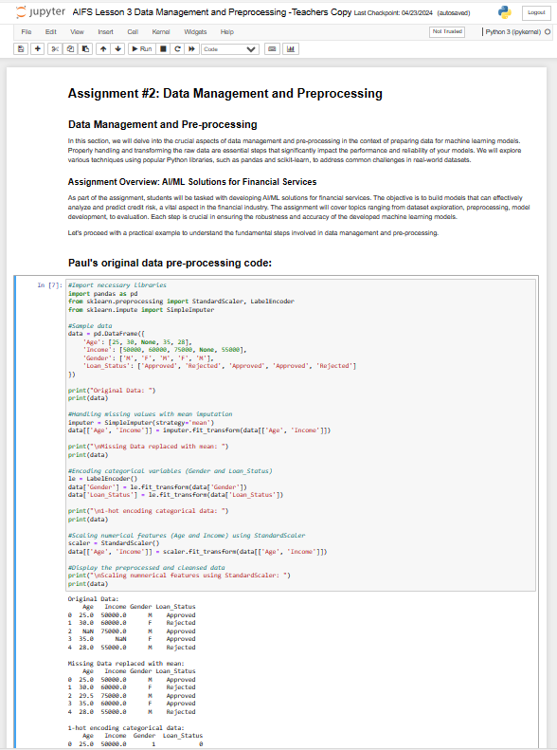
Python Jupyter Notebooks
In this course, we will be utilizing Python Jupyter Notebooks as our primary programming environment. Jupyter Notebooks provides an interactive, web-based interface for writing and executing code, visualizing data, and sharing findings.
We recommend that you use the Anaconda distribution of Python, which includes Jupyter Notebooks and a wide range of scientific computing libraries. Alternatively, you can use Google Collaboratory, a could-based Jupyter Notebook environment that requires no local installation: Google Colab

Slide 25
Defining Target Variables
1
Binary Targets
2
Continuous Targets
Indicate two possible outcomes, such as default vs. non-default on loans.
Represent a spectrum of values, like the amount of money spent by customers.
3
Categorical Targets
4
Ordinal Targets
Non-ordered categories, such as types of bank transactions.
Ordered categories, like credit score rankings.

Slide 26




1
Binary Targets
Pros and Cons
Pros: Simple to model and interpret
Cons: Limited to scenarios with only two outcomes, ignoring complexities of more varied scenarios.
Watch Out!
Risk of model bias if one outcome is significantly more common than the other.
1 / 0
Best Practices
Ensure balanced representation of both categories in the dataset to prevent model bias.
Example
Predicting loan default (default vs. non-default)

Slide 27
2
Continuous Targets
Pros and Cons
Pros: Captures nuances in data with a spectrum of values
Cons: More susceptible to outliers and noise
Watch Out!
Ensure the data does not have extreme values that could skew the model’s distribution.
1.76
Best Practices
Normalize or standardize data to handle scale differences.
Example
Predicting the amount a customer will spend in a given month.

Slide 28
3
Categorical Targets
Pros and Cons
Pros: Useful in classification problems where outcomes can be several distinct categories
Cons: Requires encoding techniques to convert categories into model-readable forms
Watch Out!
Watch for high cardinality which can make models complex and less interpretable
Red Green Blue
Best Practices
Use encoding methods like one-hot encoding or label encoding carefully
Example
Classifying types of transactions (e.g., deposits, withdrawals, payments).

Slide 29
4
Ordinal Targets
Pros and Cons
Pros: Reflects the inherent order in the outcome
Cons: The distance between categories is not uniform, which can be challenging to model accurately.
Watch Out!
Misinterpreting the ordinal data as interval data can lead to incorrect model assumptions.
First Second Third
Best Practices
Treat as categorical but respect the order in analysis and modeling.
Example
Credit rating scores categorized into ranges like low, medium and high risk.

Slide 30
Target Variable Cheat Sheet
Variable Type | Definition | Common AI/ML Algorithms | Common in Finance | Pros | Cons | Event Rate Consideration
Binary | Targets that have two classes (e.g., yes/no, true/false). | Logistic Regression, Decision Trees, SVM, Random Forests, Gradient Boosting Machines | Credit Scoring, Fraud Detection | Simplifies problem solving, direct implementation | Limited to two classes, may require data balancing | Data balancing for low event rates (undersampling, oversampling)
Continuous | Targets with a continuous range of values. | Linear Regression, Polynomial Regression, SVR, Neural Networks | Predicting Stock Prices, Interest Rates Forecasting | Can capture more nuanced relationships | Sensitive to outliers, can be complex to interpret | N/A
Categorical | Targets with more than two categories that do not have an inherent order. | Decision Trees, Random Forests, Naïve Bayes, Neural Networks | Transaction Categorization, Customer Segmentation | Flexible, handles multiple classes well | Requires more data to train effectively, can be computationally intensive | N/A
Ordinal | Targets with a set of ordered categories. | Ordinal Regression, Gradient Boosting Machines, Ordered Logistic Regression | Credit Rating Classification, Educational Level Ranking | Preserves the order of categories, intuitively interpretable | More complex models, assumptions about the spacing of categories | N/A

Slide 31

Predictors and Event Rates
Predictors
Variables used to predict the target, such as age, income and credit history. They may include both numeric and categorical data types
Event Rate
The proportion of positive instances (e.g., loan defaults) among all instances. Low event rates may require techniques like oversampling, undersampling, or synthetic data generation to balance the dataset.
 | Regression | Classification
General Description | Regression means to predict the output value using training data | Classification means to output the group into a class
Example | Regression to predict the value ($ amount) of an insurance claim using training data | Classification to predict the type of an insurance claim (fraud vs non-fraud) using training data
Target Variable | If it is a real number/continuous, then it is a regression problem | If it is a discrete/categorical variable, then it is a classification problem
$y= β_{0}+ β_{1}X_{1}+β_{2}$ $X_{2}+…+β_{0}$ $β_{0}$ + ɛ
y | X
Target | Feature
Dependent Variable | Independent Variable
Response Variable | Control Variable
Predicted Variable | Predictor Variable
Explained Variable | Explanatory Variable
Regressand | Regressor
Rules of Thumb
Event rates below 5-10% are often considered imbalanced and may require special handling. Larger datasets can typically handle lower event rates without overfitting.

Slide 32

Predictors and Event Rates
Predictors
Variables used to predict the target, such as age, income and credit history. They may include both numeric and categorical data types
Event Rate
The proportion of positive instances (e.g., loan defaults) among all instances. Low event rates may require techniques like oversampling, undersampling, or synthetic data generation to balance the dataset.
 | Regression | Classification
General Description | Regression means to predict the output value using training data | Classification means to output the group into a class
Example | Regression to predict the value ($ amount) of an insurance claim using training data | Classification to predict the type of an insurance claim (fraud vs non-fraud) using training data
Target Variable | If it is a real number/continuous, then it is a regression problem | If it is a discrete/categorical variable, then it is a classification problem
$y= β_{0}+ β_{1}X_{1}+β_{2}$ $X_{2}+…+β_{n}$ $X_{n}$ + ɛ
y | X
Target | Feature
Dependent Variable | Independent Variable
Response Variable | Control Variable
Predicted Variable | Predictor Variable
Explained Variable | Explanatory Variable
Regressand | Regressor
Rules of Thumb
Event rates below 5-10% are often considered imbalanced and may require special handling. Larger datasets can typically handle lower event rates without overfitting.

Slide 33
Data Splitting and Cross-Validation
1
Train/Test/OOT
Same Time Period
Future Time Period
Dividing data into distinct sets for training, testing and out-of-time (OOT) validation, reflecting real-world application where models predict future events.
Round 1 |  | Test Data | Training Data
Round 2 |  | Training Data | Test Data | Training Data
Round 3 |  | Training Data |  | Test Data | Training Data
Round 4 |  | Training Data |  |  | Test Data | Training Data
Round 5 |  | Training Data |  |  |  | Test Data
2
Cross-Validation
A method that divides data into subsets, using each in turn for testing and training, to ensure model reliability across various data samples.
3
Best Practices
Ensure balance between data segments to prevent model bias, and regularly update the OOT set to capture evolving trends and patterns.

Slide 34
Data Splitting and Cross-Validation Cheat Sheet
Data Splitting Type | Standard Train/Test/OOT | Cross-Validation
Definition | Dividing the dataset into separate sets for training, testing, and out-of-time (OOT) validation. | A method where the dataset is split into k-folds, and the model is trained and tested k times, each time with a different fold as the test set.
Distinction | This approach separates data based on time or events, reflecting real-world application. | Provides a thorough assessment by using each data point for both training and validation.
Use Cases | Ideal for time-sensitive models like financial forecasting where model drift is a concern. | Useful for models where data is not time-dependent and the dataset is not large
Pros | - Reflects temporal shifts in data - Clear performance evaluation on unseen data - OOT reflects real-world performance | Reduces the chance of overfitting Utilizes the entire dataset for validation Provides a comprehensive model robustness check
Cons | - Not suitable for small datasets due to less training data - May lead to overfitting if not properly managed | - Computationally intensive - Not suitable for time-series data - May not reflect temporal trends
Best Practices | - Ensure chronological separation - Use OOT for final model validation | - Use k-folds relevant to the size of the data - Avoid using with time-series data - Shuffle data for random sampling

Slide 35



The Curse of Dimensionality
What is the Curse of Dimensionality?
Impact in Finance
Dimensionality Reduction Techniques
In trading algorithms or risk assessment models, an excessive number of features can lead to a complex, computationally intensive model that is likely to overfit to the training data rather than capturing the true underlying patterns.
A challenge encountered when the number of features (dimensions) in a dataset is too high, causing the available data to become sparse and less representative
Methods like Principal Component Analysis (PCA) can reduce the feature space while preserving the variance in data, simplifying the model without significant loss of information

Slide 36

Overfitting and Underfitting in Financial Models
Bias-Variance Tradeoff
Test Data
1
The balance between a model’s complexity (to capture financial trends) and simplicity (to avoid noise), representing the optimal point where the total error is minimized.
High Bias Low Variance
Low Bias High Variance
Underfitting
Overfitting
Error
Underfitting
2
When a model is too simple to learn the underlying pattern of the data, resulting in poor performance on both training and new data.
Training Data
Bias-Variance Tradeoff
Model Complexity
Overfitting
Optimal Point – Where both bias and variance are minimized, resulting in the lowest overall error on unseen data.
3
When a model learns the training data too well, including noise and outliers, leading to poor performance on new, unseen data.

Slide 37
Overfitting and Underfitting in Financial Models
Bias-Variance Tradeoff
Test Data
1
The balance between a model’s complexity (to capture financial trends) and simplicity (to avoid noise), representing the optimal point where the total error is minimized.
High Bias Low Variance
Low Bias High Variance
Underfitting
Overfitting
Error
Underfitting
2
When a model is too simple to learn the underlying pattern of the data, resulting in poor performance on both training and new data.
Training Data
Bias-Variance Tradeoff
Model Complexity
Overfitting
Underfitting – The model is too simple, and we should increase the model complexity to reduce the error further
3
When a model learns the training data too well, including noise and outliers, leading to poor performance on new, unseen data.

Slide 38
Overfitting and Underfitting in Financial Models
Bias-Variance Tradeoff
Test Data
1
The balance between a model’s complexity (to capture financial trends) and simplicity (to avoid noise), representing the optimal point where the total error is minimized.
High Bias Low Variance
Low Bias High Variance
Underfitting
Overfitting
Error
Underfitting
2
When a model is too simple to learn the underlying pattern of the data, resulting in poor performance on both training and new data.
Training Data
Bias-Variance Tradeoff
Model Complexity
Overfitting
Overfitting – The model is too complex, and we should reduce the model complexity to reduce the error further
3
When a model learns the training data too well, including noise and outliers, leading to poor performance on new, unseen data.

Slide 39
Performance Metrics
Performance metrics provide crucial insights into a model's accuracy and reliability by quantifying its performance across various data sets. This helps in identifying if the model is underfitting, overfitting, or well-fitted:
Training Dataset: Metrics calculated on this dataset help in understanding how well the model fits the data it was trained on. High performance here doesn't guarantee generalization to unseen data.
Test Dataset: Metrics here show how the model performs on a separate set of data not seen during training, providing insights into its generalization capabilities.
Out-Of-Time (OOT) Dataset: Evaluating the model on data from a different time period tests its robustness over time and against external changes, crucial for time-sensitive financial models.
Regression Performance Metrics
Dataset | Key Metrics | Purpose | Quality Check
Training | MAE, MSE, RMSE, R-Squared | Assess model’s ability to learn for the training data. | Look for unusually low error rates or exceptionally high R-squared, indicating possible overfitting.
Testing | MAE, MSE, RMSE, Adjusted R-squared | Evaluate generalization to unseen data | Ensure metrics do not worsen significantly compared to training, which could indicate overfitting.
Out-of-Time | RMSE, Adjusted R-squared | Test model’s performance stability over time | Check for consistent performance with the training set, significant deviation my suggest model drift or overfitting.

Slide 40
Performance Metrics
Key Points to Remember
Detection of Overfitting: If metrics on the training dataset are significantly better than on the test or OOT datasets, it indicates overfitting—where the model learns the noise in the training data rather than the actual signal.
Detection of Underfitting: Poor performance across all datasets suggests underfitting, where the model is too simple to capture underlying patterns.
Cross-Validation: Helps in understanding model stability and the effect of dataset variability on model performance.
Classification Performance Metrics
Dataset | Key Metrics | Purpose | Quality Check
Training | Accuracy, Precision, Recall, F1-Score | Assess model’s ability to learn for the training data. | High values are good but excessively high scores might indicate overfitting
Testing | Accuracy, Precision, Recall, F1-Score | Evaluate generalization to unseen data | Look for similar performance to training; significant drops can suggest overfitting.
Out-of-Time | Accuracy, AUC | Test model’s performance stability over time | Performance should be in line with training and testing to avoid underfitting or overfitting.

Slide 41




Mean Absolute Error (MAE)
Mean Squared Error (MSE)
Root Mean Squared Error (MAE)
R-Squared (Coefficient of Determination)
The average of the absolute differences between the predicted values and the observed values
The average of the squares of the differences between the predicted values and the observed values
The square root of the average of the squared differences between the predicted values and the observed values
Represents the proportion of the variance in the dependent variable that is predictable from the independent variables
$$RMSE=\sqrt{\frac{1}{n}\sum_{i=1}^{n}{(y_{i}−{\hat{y}}_{i})^{2}}}$$
$$MAE=\frac{1}{n}\sum_{i=1}^{n}{|y_{i}−{\hat{y}}_{i}|}$$
$$MSE=\frac{1}{n}\sum_{i=1}^{n}{(y_{i}−{\hat{y}}_{i})^{2}}$$
$$R^{2}=\frac{\frac{1}{n}\sum_{i=1}^{n}{(y_{i}−{\hat{y}}_{i})^{2}}}{\frac{1}{n}\sum_{i=1}^{n}{(y_{i}−{\overline{y}}_{i})^{2}}}$$
01
02
03
04

Slide 42
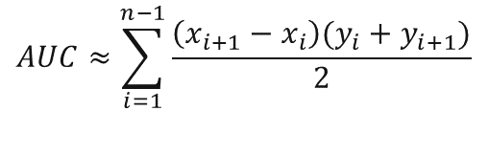
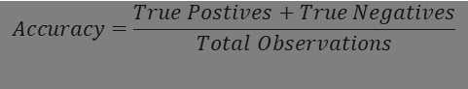
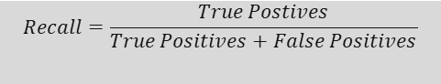
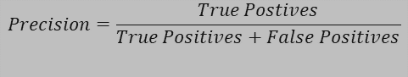
Accuracy
Precision
Recall
AUC (Area Under the ROC Curve)
The proportion of true results among the total number of cases examined
The proportion of positive identifications that were actually correct. It indicates the quality of the positive class predictions
The proportion of actual positives that were identified correctly. It focuses on the model’s ability to find all relevant instances
Represents a model’s ability to discriminate between positive and negative classes. An AUC of 0.5 suggests no discrimination ability, while 1 indicates perfect discrimination
$$Accuracy=\frac{True Postives+True Negatives}{Total Observations}$$
$$Precision=\frac{True Postives}{True Positives+False Positives}$$
$$Recall=\frac{True Postives}{True Positives+False Positives}$$
$$AUC≈\sum_{i=1}^{n−1}{\frac{\left(x_{i+1}−x_{i}\right)(y_{i}+y_{i+1})}{2}}$$
05
06
07
08

Slide 43
Performance Metrics Cheat Sheet
Model Type | Metric | Description | Ideal Value
Regression | Mean Absolute Error (MAE) | Measures the average magnitude of errors in a set of predictions, without considering their direction. | Lower values are better
 | Mean Squared Error (MSE) | Represents the average of the square of the errors – i.e., the average squared difference between the estimated values and the actual value | Lower values are better
 | R-Squared | Indicates the proportion of the variance in the dependent variable that is predictable from the independent variables. | Closer to 1 is better
 | Root Mean Squared Error (RMSE) | Square root of the average of squared differences between prediction and actual observation. | Lower values are better
Classification | Accuracy | Measures the ratio of correctly predicted observations to the total observations | Higher values are better, but can be misleading with imbalanced classes
 | Precision | Evaluates the accuracy of positive predictions | Higher values are better
 | Recall | Measures the ability of a model to find all the relevant cases (True Positives) | Higher values are better
 | F1 Score | Weighted average of Precision and Recall. Useful when you need to balance Precision and Recall | Higher values are better
 | ROC-AUC | Represents degree or measure of separability. It tells how much the model is capable of distinguishing between classes. | Closer to 1 is better
Example Python code to develop RMSE and AUC
from sklearn.metrics import mean_squared_error, roc_auc_score
import numpy as np
# Example predictions and actuals
y_true = [3, -0.5, 2, 7]
y_pred = [2.5, 0.0, 2, 8]
# Calculating RMSE
mse = mean_squared_error(y_true, y_pred)
rmse = np.sqrt(mse)
print("Root Mean Square Error (RMSE):", rmse)
# Example binary classification predictions and actuals
y_true_class = [1, 0, 1, 1]
y_pred_probs = [0.9, 0.1, 0.8, 0.7] # Predicted probabilities for the positive class
# Calculating AUC
auc = roc_auc_score(y_true_class, y_pred_probs)
print("Area Under the Curve (AUC):", auc)
Classification Models
Categorize data into predefined labels. Application include fraud detection and customer segmentation.
2

Slide 44

Advanced Topics
Batch vs Online Learning
1
Batch learning processes large volumes of data in a single or few comprehensive runs, while online learning updates predictions in real-time, learning incrementally with each new data point.
Transparent vs Black Box Models
2
Transparent models have a clear decision-making process, while black box models are complex, with the reasoning behind decisions not easily discernible
The “No Free Lunch” Theorem
3
The idea that no one model is best for all problems, and model effectiveness depends on the specific application.

Slide 45
Advanced Topics
Batch vs Online Learning
1
Batch learning processes large volumes of data in a single or few comprehensive runs, while online learning updates predictions in real-time, learning incrementally with each new data point.
Transparent vs Black Box Models
2
Transparent models have a clear decision-making process, while black box models are complex, with the reasoning behind decisions not easily discernible
The “No Free Lunch” Theorem
3
The idea that no one model is best for all problems, and model effectiveness depends on the specific application.

Slide 46
Advanced Topics
Batch vs Online Learning
1
Batch learning processes large volumes of data in a single or few comprehensive runs, while online learning updates predictions in real-time, learning incrementally with each new data point.
Transparent vs Black Box Models
2
Transparent models have a clear decision-making process, while black box models are complex, with the reasoning behind decisions not easily discernible
The “No Free Lunch” Theorem
3
The idea that no one model is best for all problems, and model effectiveness depends on the specific application.

Slide 47
Q&A
Reminder:
Multiple-choice quiz will be released directly after class. The 5-question quiz is based on the topics covered today.
Intro to Data Science Jupyter Notebook:
This notebook contains python code and examples to get you up and running in python

